Slide 1


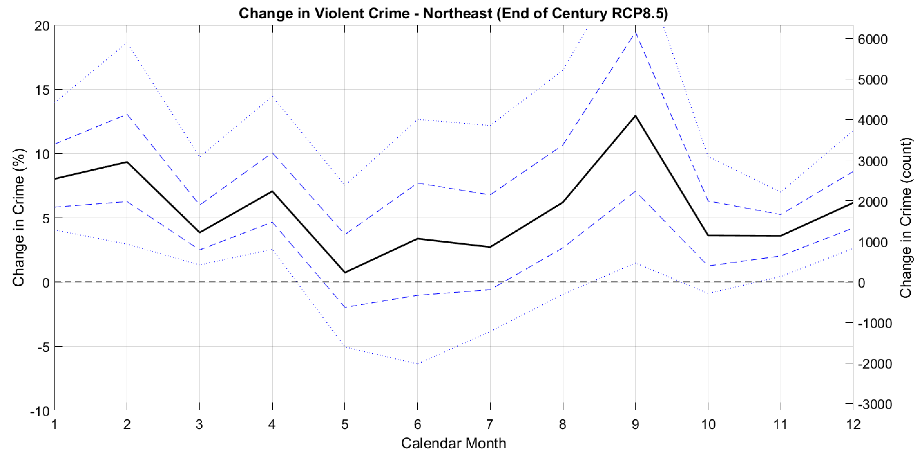
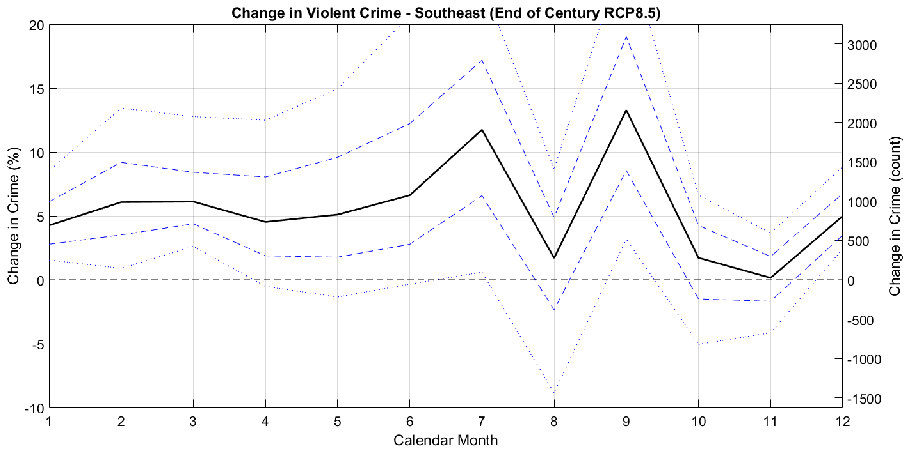
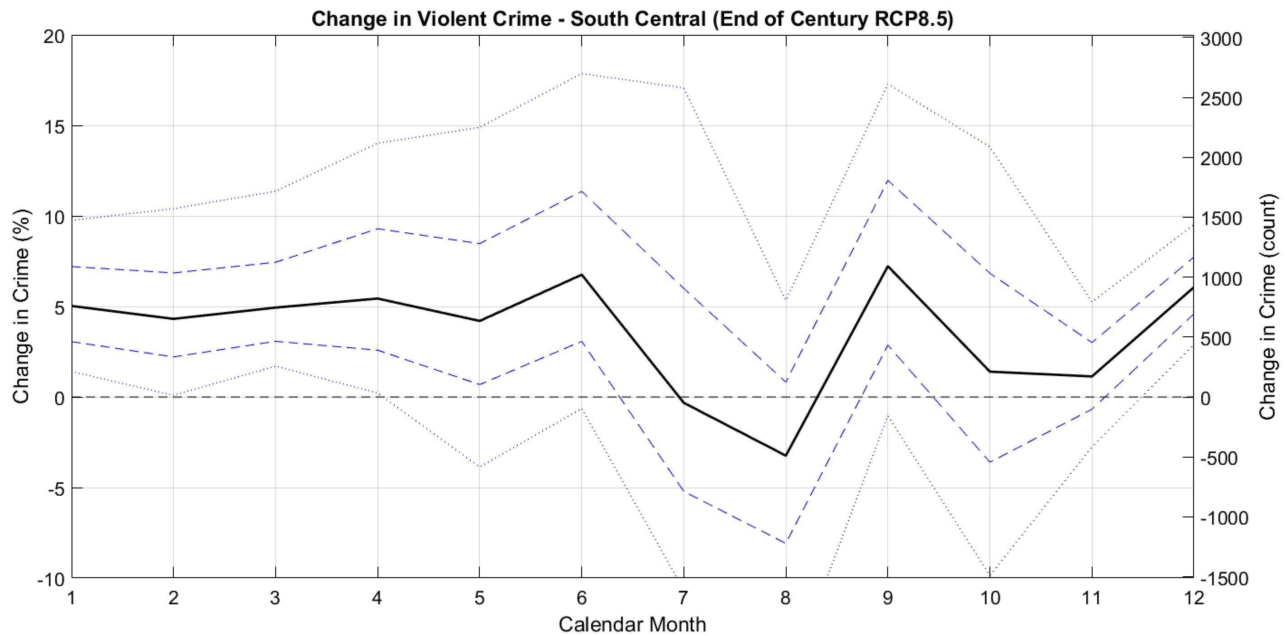
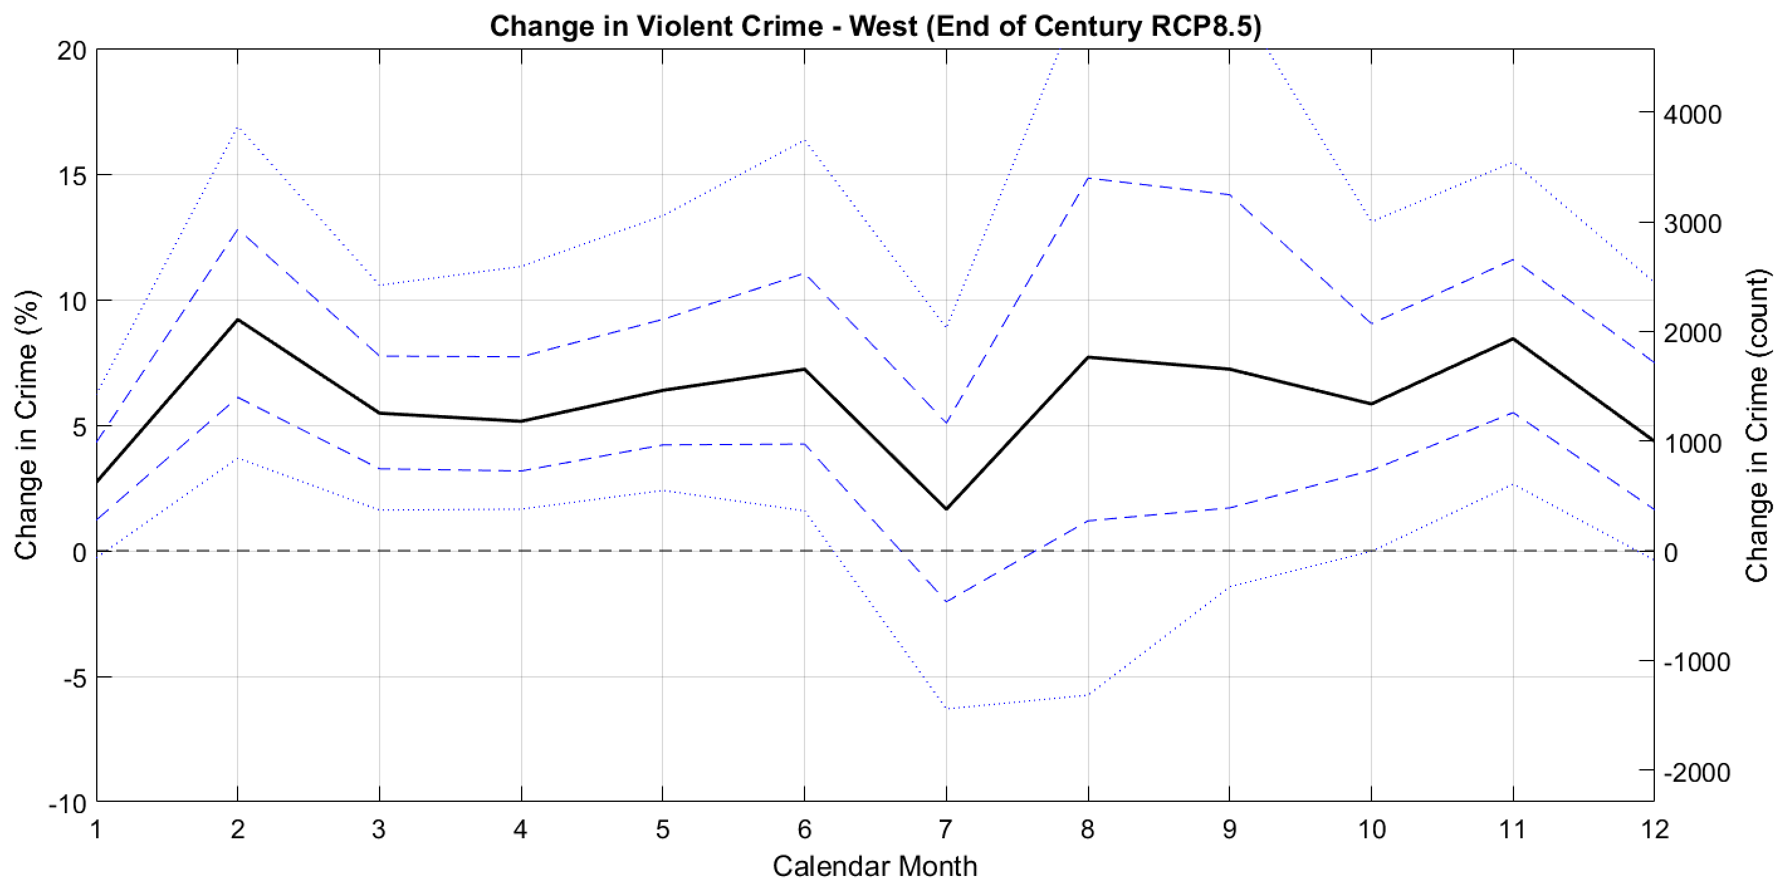
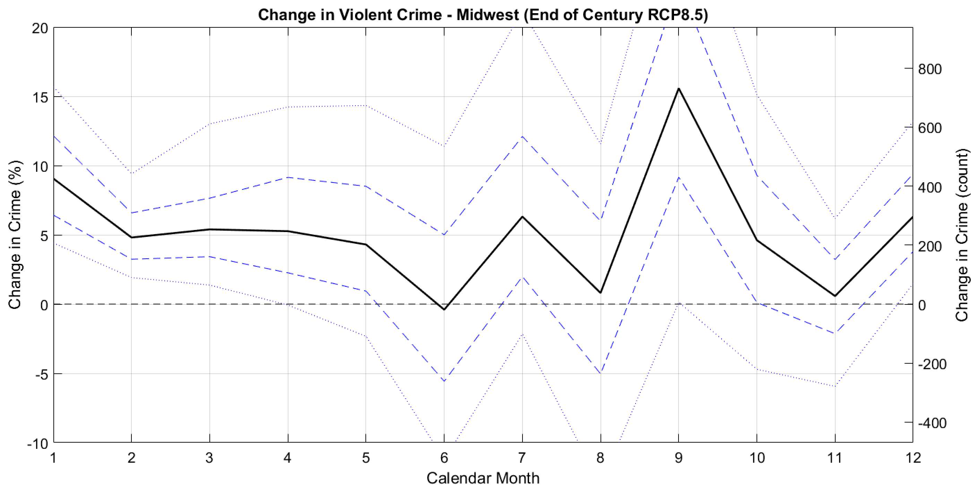
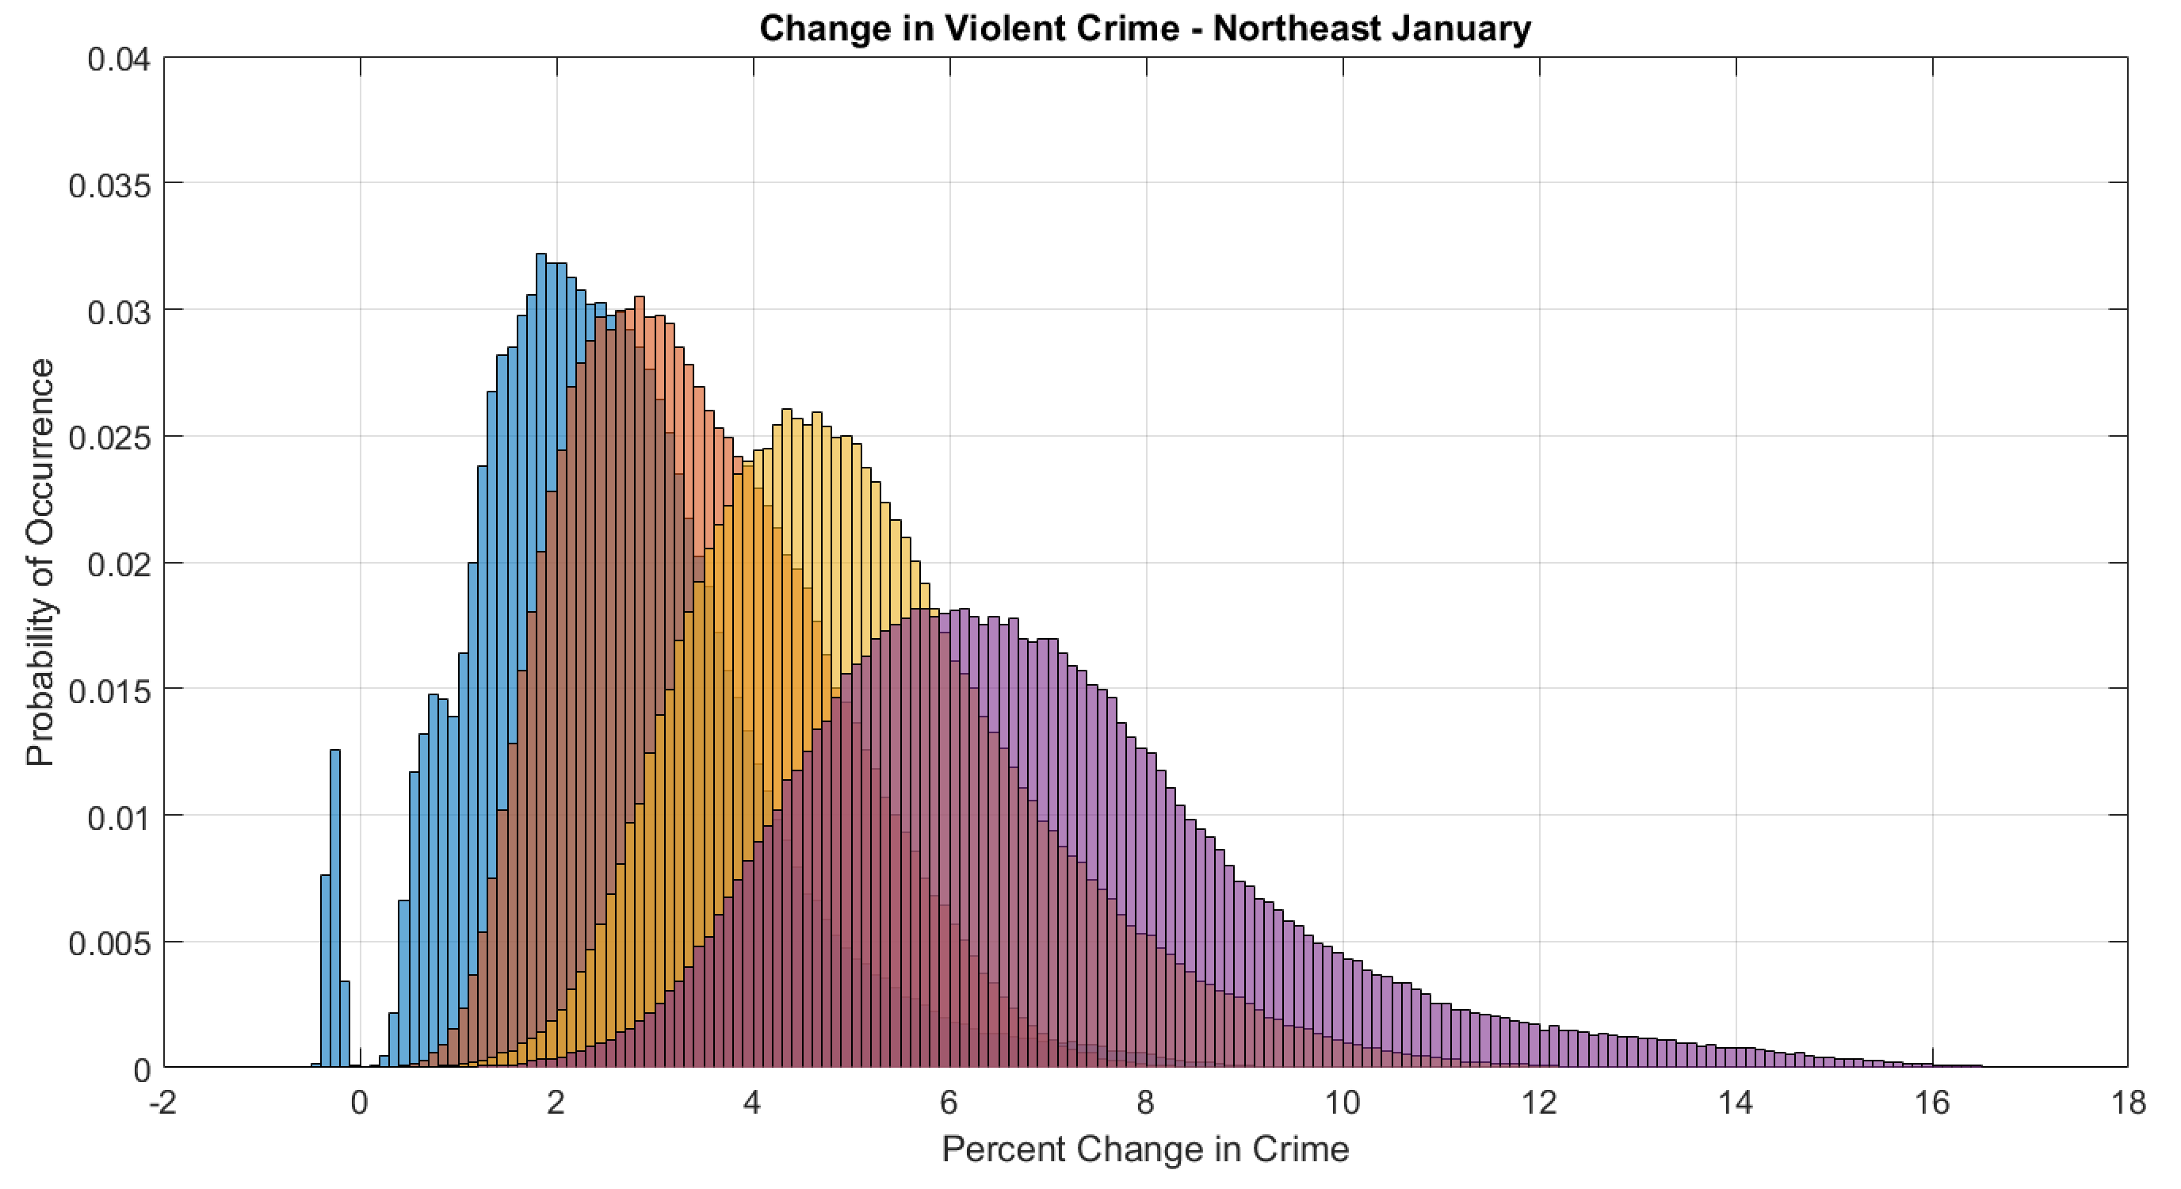
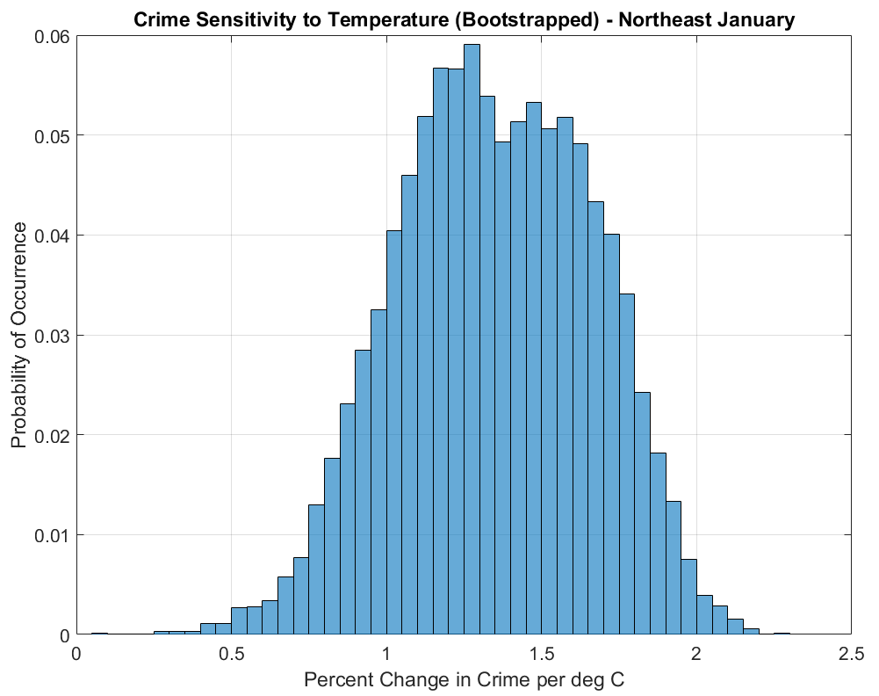
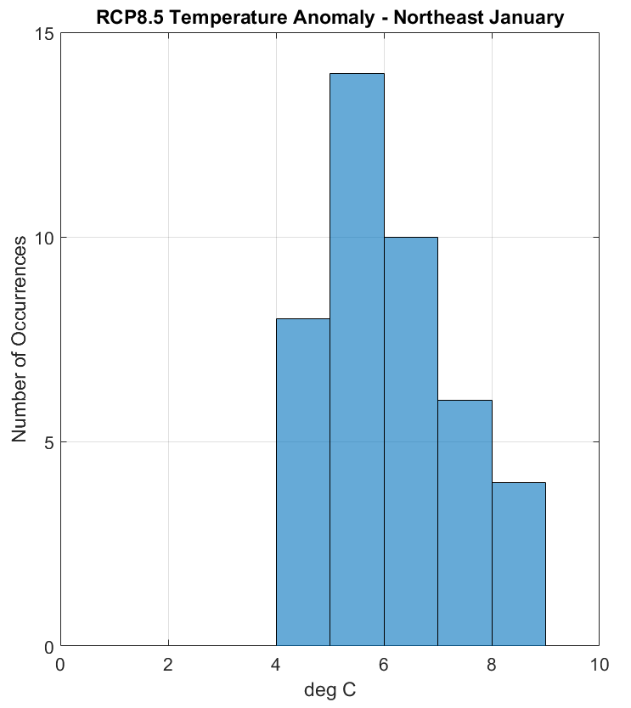
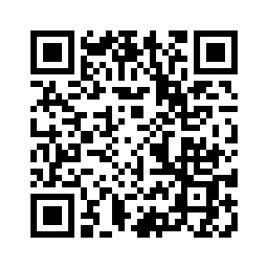
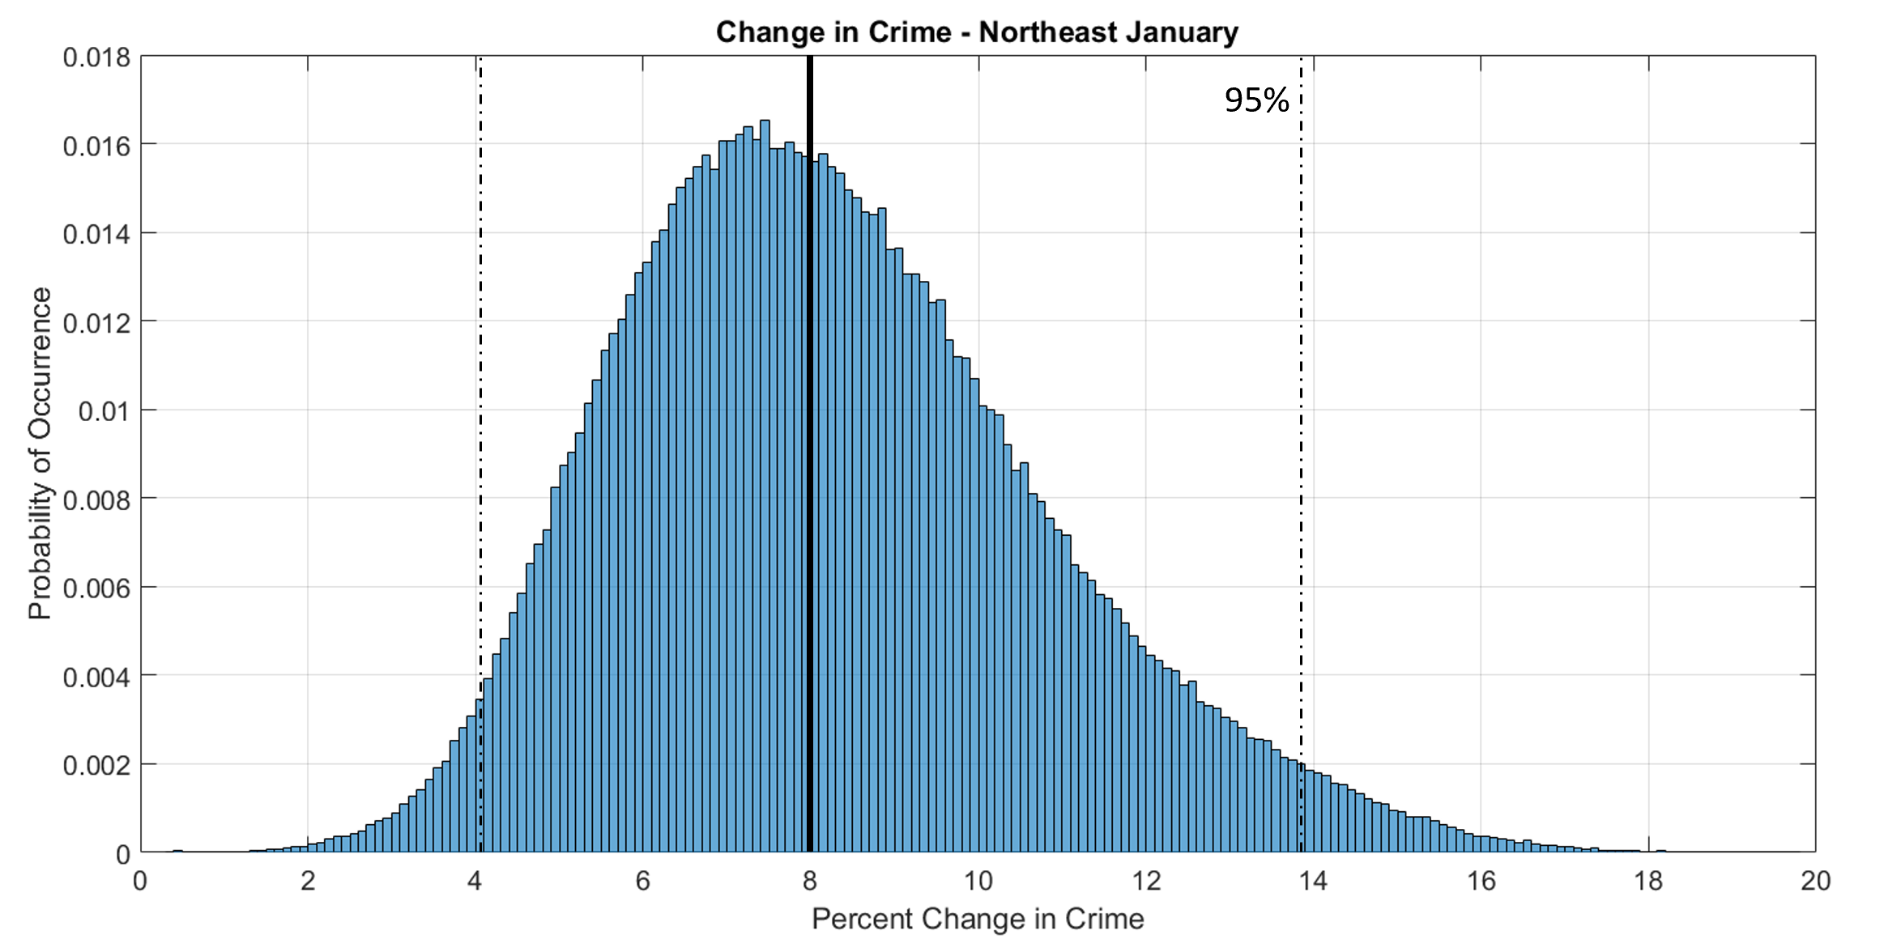
It is possible to quantify a relationship between crime and temperature and project that relationship into the future using climate model output. Estimated additional violent crimes by the end of the century attributable to temperature range in the upper hundreds of thousands to several million for the US (using 2014 crime baselines).
Projecting Future Temperature-Driven Changes in Crime
Ryan D. Harp^{1,2,3}
¹Earth Lab, University of Colorado Boulder, Boulder, Colorado, USA
² Department of Atmospheric and Oceanic Sciences, University of Colorado Boulder, Boulder, Colorado, USA
³Cooperative Institute for Research in Environmental Sciences (CIRES), University of Colorado Boulder, Boulder, Colorado, USA
Background on Crime-Climate Relationship
Background literature has demonstrated a positive relationship between temperature and crime rates. The nuances of the relationship vary depending on the crime type but most results show a clear linear trend.
The Routine Activities Theory is the most likely mechanism. Pleasant weather leads to increased interpersonal encounters and greater victim availability. Given natural climate seasonality, the Routine Activities Theory is a stronger driver in the winter months when weather is harsher.
Determining Crime Sensitivity to Temperature
Crime data and climate data were gathered from the Federal Bureau of Investigation’s (FBI) Uniform Crime Reporting database (UCR) and NOAA’s North American Regional Reanalysis (NARR) and span from 1979-2016.
Agency data were combined across five internally consistent US regions (see Harp and Karnauskas, 2018).
Climate Model Projections
Surface air temperatures were taken from the historical (47 models; 1850-2005), RCP4.5 (30 models; 2006-2100), and RCP8.5 (42 models; 2006-2100) experiments of the CMIP5.
Output from mid-century and end-of-century time periods, along with projections for different levels of global warming (1.5, 2, 3, and 4 degrees Celsius), were multiplied by the bootstrapped sensitivities.
Projections of the Change in Crime Across Calendar Months and Regions
Back of the envelope calculations estimate additional US crimes attributable to temperature at 1.4 million violent (740,000 property) crimes for the RCP4.5 scenario and 2.4 million violent (1.2 million property) crimes for the RCP8.5 scenario by the end-of-the-century.
Things to Consider
Climate is just one input into the overall crime rate. This is not a prediction of how much crime will occur!
The sensitivity of crime to temperature may change over time if people’s behaviors adapt to a warmer climate.
Applying a relationship derived from interannual variability to future climate projections is common practice but imperfect.
The sensitivity of crime to temperature can be calculated by taking the slope of the linear relationship for each region-month. This calculation was bootstrapped 10,000 times to characterize the uncertainty.
Northeast January
2˚C
Additional violent crimes for one January in the Northeast between 1.5˚C of warming and:
2˚C: 3,400
3˚C: 9,500
4˚C: 15,800
1.5˚C
3˚C
4˚C
Sensitivity of crime to temperature
x
Climate model temp. projections
For More Information
Email: ryan.harp@colorado.edu
Twitter: @ryandharp
Acknowledgments
The author thanks the FBI and NOAA for use of the UCR and NARR data sets, respectively. In addition, the author acknowledges the World Climate Research Program’s Working Group on Coupled Modeling and affiliated climate modeling groups for distribution of their model output.
Scan QR Code to view foundational publication:
Harp, R. D., & Karnauskas, K. B. (2018). The Influence of Interannual Climate Variability on Regional Violent Crime Rates in the United States. GeoHealth, 2(11), 356-369.
=
Full distribution of probability of projected changes in crime
Notes:
Notes:
In Powerpoint, click View > Guides
Keep text within gutter guides.
Author list: Don’t split names onto two lines (e.g., “Jimmy [break] Smith”). If that happens, use a new line, unless you need the space. Bold the first names of anybody who’s presenting in person.
Intro/methods/result: Do not drop below font size 28, but if you have extra space, jack up the font size until the space is full.
Do not use color in the sidebars except in graphs/figures. It’ll pull attention from the center and slow interpretation for passersby.

